Slide 2
Storage Latency for Oracle DBAs
Luca Canali – CERN
Marcin Blaszczyk - CERN

Slide 3
Outline
CERN and Oracle
Latency: what is the problem we are trying to solve
Storage latency in Oracle
Examples
Tools
Conclusions

Slide 4
Outline
CERN and Oracle
Latency: what is the problem we are trying to solve
Storage latency in Oracle
Examples
Tools
Conclusions

Slide 5
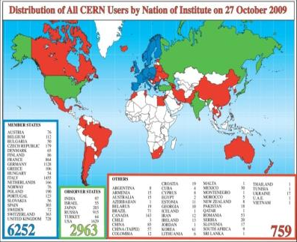
CERN
European Organization for Nuclear Research founded in 1954
20 Member States, 7 Observer States + UNESCO and UE
60 Non-member States collaborate with CERN
2400 staff members work at CERN as personnel, 10 000 more researchers from institutes world-wide

Slide 6
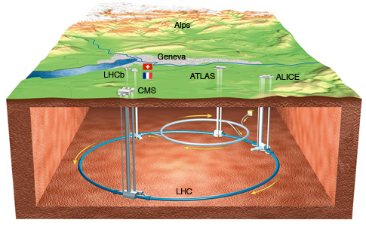
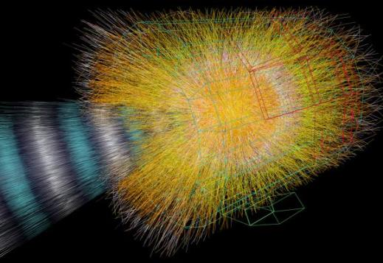
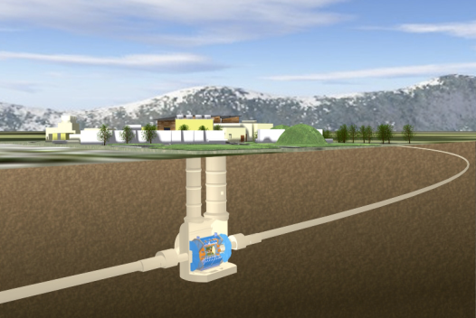
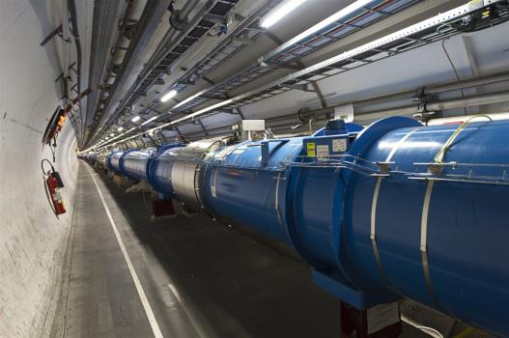
LHC, Experiments, Physics
Large Hadron Collider (LHC)
World’s largest and most powerful particle accelerator
27km ring of superconducting magnets
Currently undergoing upgrades, restart in 2015
The products of particle collisions are captured by complex detectors and analyzed by software in the experiments dedicated to LHC
Higgs boson discovered!
The Nobel Prize in Physics 2013 was awarded jointly to François Englert and Peter W. Higgs "for the theoretical discovery of a mechanism that contributes to our understanding of the origin of mass of subatomic particles, and which recently was confirmed through the discovery of the predicted fundamental particle, by the ATLAS and CMS experiments at CERN's Large Hadron Collider"
Notes:
New particle discovery: see also CMS and Atlas announcement on July 4th 2012.

Slide 7
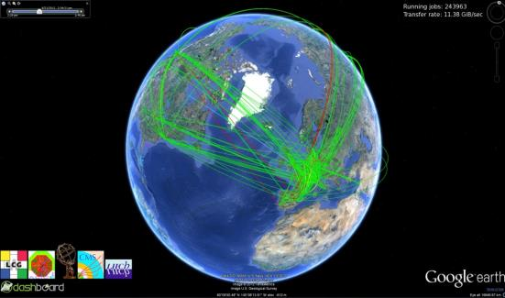
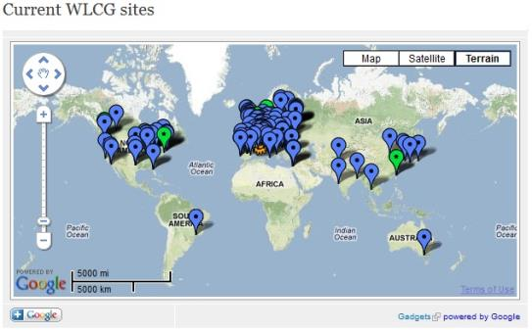
WLCG
The world’s largest scientific computing grid
More than 100 Petabytes of data stored and analysed. Increasing: 20+ Petabytes/year
Over 68 000 physical CPUs
Over 305 000 logical CPUs
157 computer centres in 36 countries
More than 8000 physicists with real-time access to LHC data

Slide 8
CERN’s Databases
~100 Oracle databases, most of them RAC
Mostly NAS storage plus some SAN with ASM
~500 TB of data files for production DBs in total
Examples of critical production DBs:
LHC logging database ~170 TB, expected growth up to ~70 TB / year
13 Production experiments’ databases
Relational DBs play a key role in the LHC production chains
Accelerator logging and monitoring systems
Online acquisition, offline: data (re)processing, data distribution, analysis
Grid infrastructure and operation services
Monitoring, dashboards, etc.
Data management services
File catalogues, file transfers, etc.
Metadata and transaction processing for tape storage system

Slide 10
Outline
CERN and Oracle
Latency: what is the problem we are trying to solve
Storage latency data in Oracle
Examples
Tools
Conclusions

Slide 11
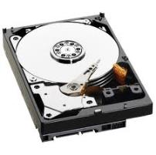
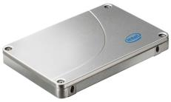
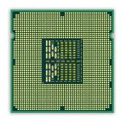
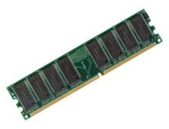
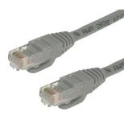
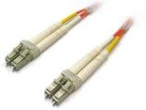
Latency
Latency, a measure of time.
In the context of this presentation: time to access data

Slide 12
Understanding Latency
How long I should wait for baby elephant?
Elephant gestation period ~22 month
Latency: 22 months

Slide 13
Understanding Throughput
What if I want 2 baby elephants?
Throughput has doubled:
2 elephants in 22 months
Latency: still 22 months

Slide 14
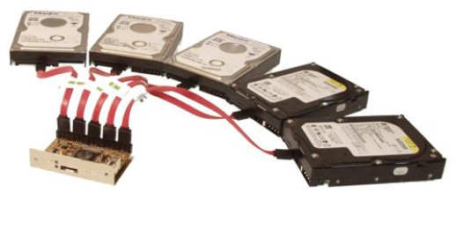
I/O Operations Per Second
IOPS is a measure of throughput
IOPS depends also on latency
Latency differs for
‘random’ reads
‘sequential’ reads
How can we get more IOPS without increasing the latency?
Use Many HDDs!

Slide 15
Why We Care About Storage Latency
Performance analysis and tuning:
Where is the time spent during a DB call?
What response time do the users see from the DB?
OLTP-like workloads:
Response time can be dominated by I/O latency
Index-based access, nested loops joins

Slide 16
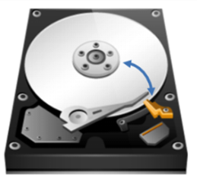
Physical Sources of Latency
Blocking I/O calls:
Think access to a large table via an index
Random access
HDD: head movement and disk spinning latency

Slide 17
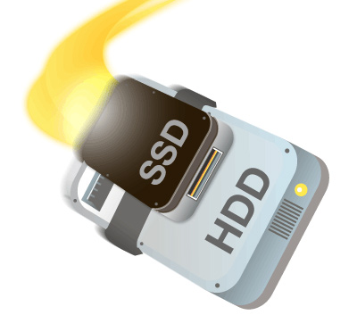
What can we do: Hardware
Current trends for HW
Large SSD cache in storage
Tiered storage
Servers with large amounts of memory
Reduce (random) reads
Caching large amounts of data
Trends towards in-memory DBs
A balance act performance vs. cost

Slide 18
What can we do: Software
Big gains in application/SQL optimization
SW optimisation beats HW optimisation most of the times
Oracle tuning:
Understand when single-block access is not optimal
Full scan vs. index-based access
Hash join vs. nested loop
In general: get a good execution plan

Slide 19
So Where is the Problem?
DB Admin:
- Storage is slow!
Storage Admin:
- The problem is with the DB!
Reality check:
Lack of clear storage performance data.
Changing database workloads.

Slide 20
Outline
CERN and Oracle
Latency: what is the problem we are trying to solve
Storage latency in Oracle
Examples
Tools
Conclusions

Slide 21
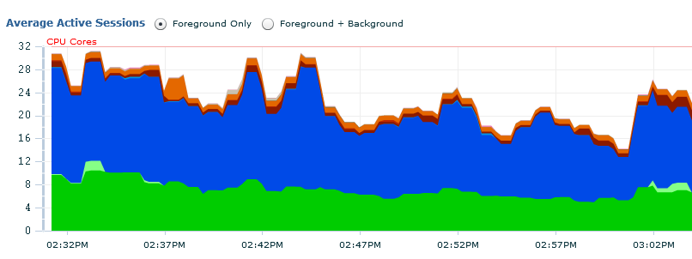
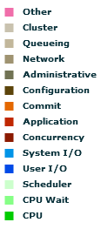
Transactional Workload
Example from OEM
DB time dominated by ‘db file sequential read’
CPU is not a bottleneck
Ignore locks and other serialization events

Slide 22
Oracle Wait Events
Can we troubleshoot a storage issue from the DB engine?
Not in the general case
What can we do?
Oracle wait event instrumentation is great
Wait event histograms is a key source of data

Slide 23
Wait Event Analysis
We want to drill down
‘db file sequential read’ wait event
Also useful for ‘log file sync’ event
What can we gain?
Make educated guesses of what is happening on the storage
Attack the root causes of the problem

Slide 24
A Story From Our Production
Migrated to a new storage system
NAS storage with SSD cache
Good performance: because of low-latency reads from SSD
Issue:
From time to time production shows unacceptable performance
Analysis:
The issue appears when the backup runs!

Slide 25
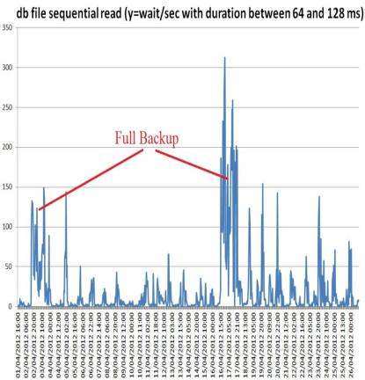
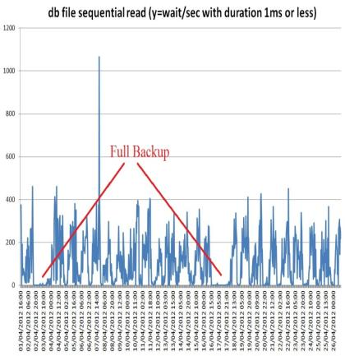
Wait Event Drill Down
Number of waits
Very slow reads appear
Reads from SSD cache go to zero
Notes:
Data taken from AWR and in particular wait event histograms data aggregating over RAC nodes.
Example:
select cast(sn.begin_interval_time as date) snap_time,
--eh.dbid,
sn.instance_number,
eh.event_name,
eh.wait_time_milli,
--eh.wait_count,
eh.wait_count - lag(eh.wait_count) over (partition by eh.dbid,eh.instance_number,eh.event_id,eh.wait_time_milli order by sn.snap_id nulls first) Delta_wait_count,
round((eh.wait_count - lag(eh.wait_count) over (partition by eh.dbid,eh.instance_number,eh.event_id,eh.wait_time_milli order by sn.snap_id nulls first)) /
(extract(hour from END_INTERVAL_TIME-begin_interval_time)*3600
-extract(hour from sn.snap_timezone - lag(sn.snap_timezone) over (partition by eh.dbid,eh.instance_number,eh.event_id,eh.wait_time_milli order by sn.snap_id nulls first) )*3600 --deals with daylight savings time change
+ extract(minute from END_INTERVAL_TIME-begin_interval_time)* 60
+ extract(second from END_INTERVAL_TIME-begin_interval_time)),2 ) Rate_wait_count_per_bin
from dba_hist_event_histogram eh,
dba_hist_snapshot sn
where
sn.snap_id = eh.snap_id
and sn.dbid = eh.dbid
and sn.instance_number = eh.instance_number
and sn.begin_interval_time &delta_time_where_clause
and eh.wait_class in ('User I/O','System I/O','Commit') -- need to limit search or dump file can grow too big
order by sn.snap_id;

Slide 26
What We Found
AWR data used to examine the issue
DBA_HIST_EVENT_HISTOGRAM
Wait event: db file sequential read
I/O slow during backups
because fewer I/O requests were served from SSD
Note: how we worked around this issue
Short term: moved backup to Active Data Guard replica
Medium term: upgraded filer model

Slide 27
Lesson Learned
If response time is dominated by db_file_sequential_read
Drill down on wait event histogram
Average latency values are not good enough
Latency details provide info on what is happening on the storage

Slide 28
Real-Time Monitoring
Problem:
How to perform real-time monitoring of the event latency?
Answer: V$EVENT_HISTOGRAM
Cumulative counters
We need to compute deltas

Slide 29
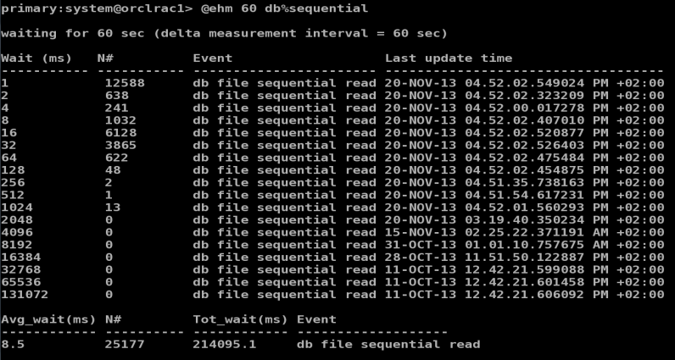
Monitoring Latency - Snapshots
Custom script: ehm.sql
Script can be downloaded from: http://canali.web.cern.ch/canali/resources.htm

Slide 30
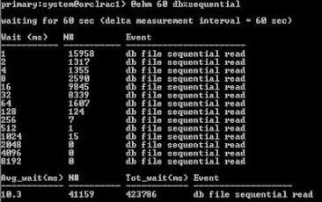
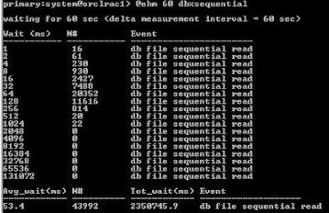
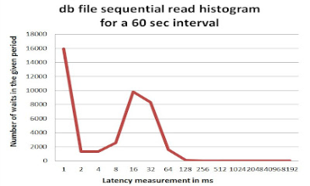
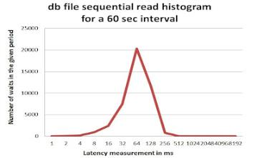
Monitoring Latency - Snapshots

Slide 31
Display Latency Data over Time
It’s a three dimensional representation:
Latency bucket, value, time
This problem has been solved before!
Heat Map representation
Used for example in Sun ZFS Storage 7000 Analytics
Reference: Brendan Gregg, Visualizing system latency, Communications of the ACM, July 2010

Slide 32
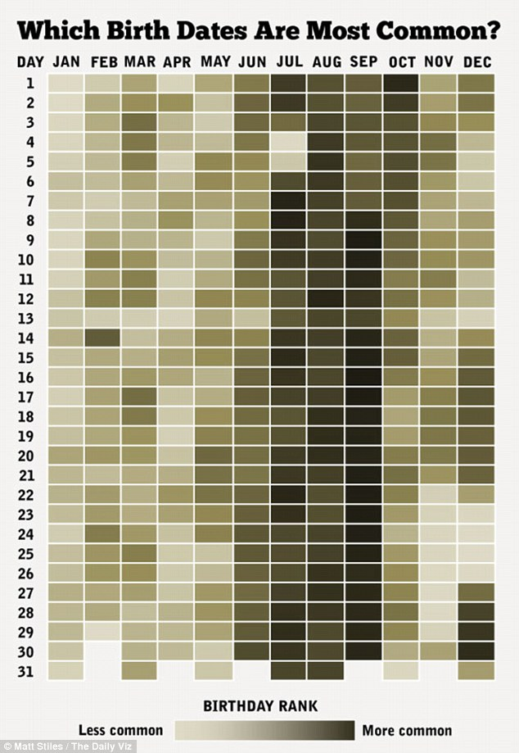
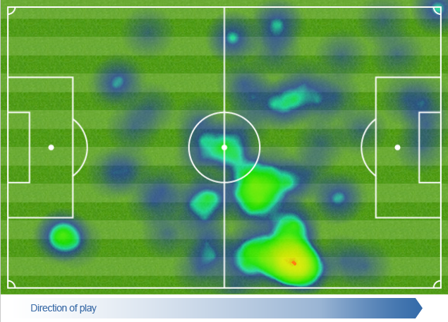
Heat Maps
By Definition
graphical representation of data where the individual values contained in a matrix are represented as colours (wikipedia)
Examples:

Slide 33
Latency Heat Maps - Frequency
X=time, Y=latency bucket
Colour=events per second (e.g. IOPS)

Slide 34
Latency Heat Maps - Frequency
X=time, Y=latency bucket
Colour=events per second (e.g. IOPS)
TIME

Slide 35
Latency Heat Maps - Frequency
X=time, Y=latency bucket
Colour=events per second (e.g. IOPS)

Slide 36
Latency Heat Maps - Frequency
X=time, Y=latency bucket
Colour=events per second (e.g. IOPS)

Slide 37
Latency Heat Maps - Frequency
X=time, Y=latency bucket
Colour=events per second (e.g. IOPS)

Slide 38
Another Metric of Interest
How much time do we wait in a given bucket?
Not directly available in v$event_histogram
How to estimate it? Example:
100 waits in the bucket 8ms means
Wait time between 100*4 ms and 100*8 ms
Approximate: 100 * 6 ms [that is 100 * ¾ * 8 ms]
Definition:
Intensity = 0.75 * bucket_value * frequency_count

Slide 39
Latency Heat Maps - Intensity
X=time, Y=latency bucket
Colour= intesity [time waited per bucket]

Slide 40
Outline
CERN and Oracle
Latency: what is the problem we are trying to solve
Storage latency in Oracle
Examples
Tools
Conclusions

Slide 41
Stress Testing
Scenarios
Investigate HW performance
Compare different systems
Example: compare current storage with a new system
It’s hard:
Choose test workloads that make sense
Understand effects of caching

Slide 42
SLOB 2
An Oracle-based stress testing tool
Search: “SLOB 2 by Kevin Closson”
Great tool generate lots of random IO
Directly from Oracle processes
Physical reads from storage
Become Oracle’s wait events for db file sequential read
Size of test data is configurable
Concurrency is configurable

Slide 43
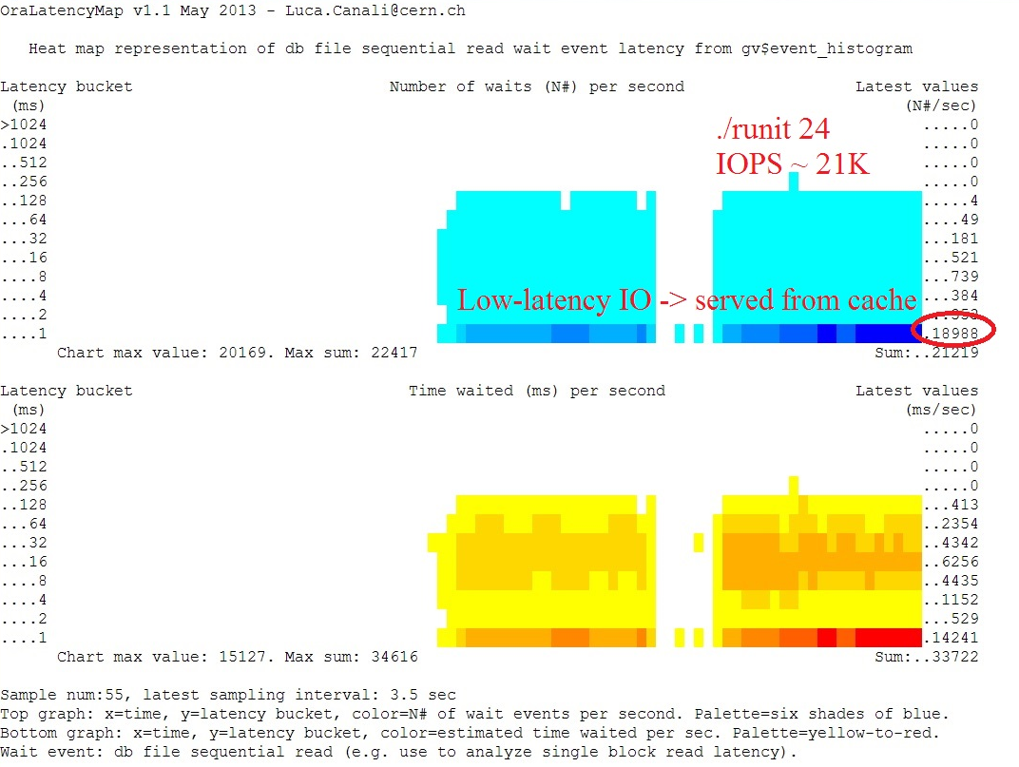
Example: “Too Good To Be True”
23 SAS disks delivering 20K IOPS?
It doesn’t make sense
Latency is the clue
Reads served by controller cache!
Lesson learned: test data size was too small

Slide 45
Example: “Too Good To Be True”
23 SAS disks delivering 20K IOPS?
It doesn’t make sense
Latency is the clue
Reads served by controller cache!
Lesson learned: test data size was too small

Slide 46
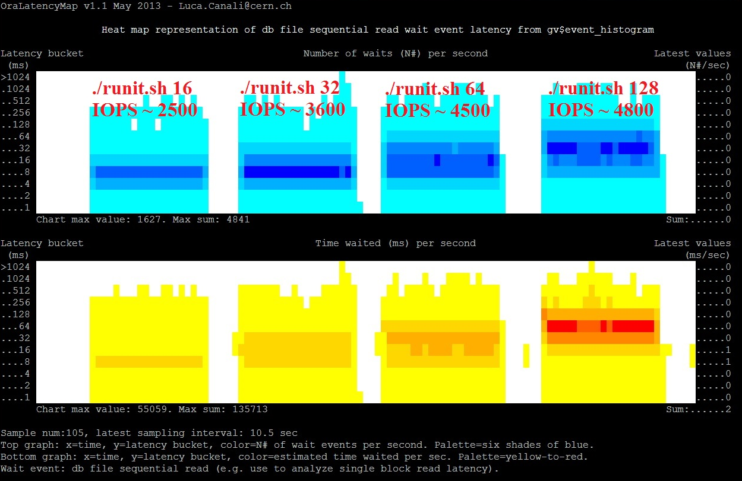
Example: “Load Till Saturation”
23 SAS disks
JBOD & ASM
4 consecutive
tests with
increasing load
Lesson learned: don’t accept IOPS numbers without latency values

Slide 47
Example: “Load Till Saturation”
23 SAS disks
JBOD & ASM
4 consecutive
tests with
increasing load
Lesson learned: don’t accept IOPS numbers without latency values

Slide 48
Example: “Load Till Saturation”
23 SAS disks
JBOD & ASM
4 consecutive
tests with
increasing load
Lesson learned: don’t accept IOPS numbers without latency values

Slide 49
IOPS and Latency are Related
Observation: as IOPS approach saturation latency increases fast
Confirmed: a simple model from queueing theory:
Calculation performed using
MMm Multiserver model
By Cary Millsap, 2003

Slide 50
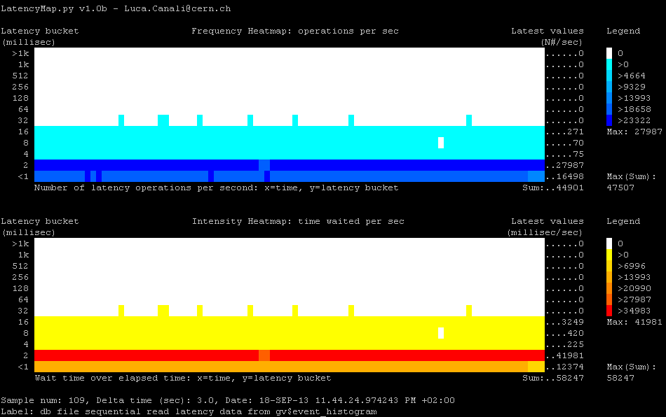
0.5 TB dataset, 100% in SSD, 56 sessions, random reads - NAS system

Slide 51
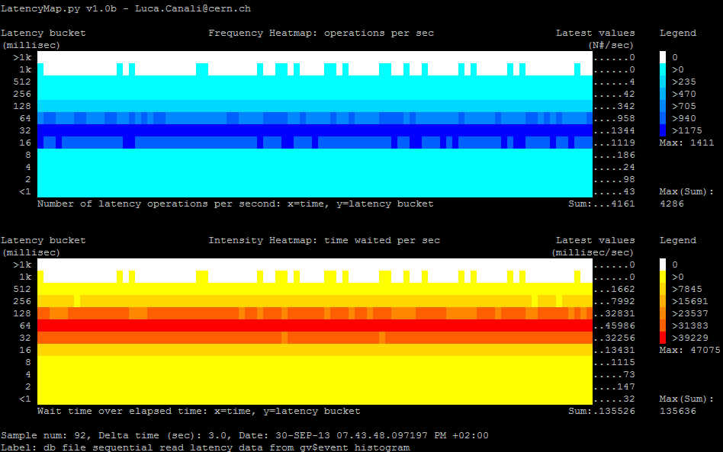
10TB dataset, 128 sessions, random reads, disk saturation - NAS system

Slide 52
Monitoring Production Systems
Understand I/O response time
Help for tuning and capacity planning
Attack questions like: is the storage slow?
Drill down on three areas:
I/O served by SSD/controller cache
I/O served by physical disk ‘spindles’
I/O with very large latency: outliers

Slide 53
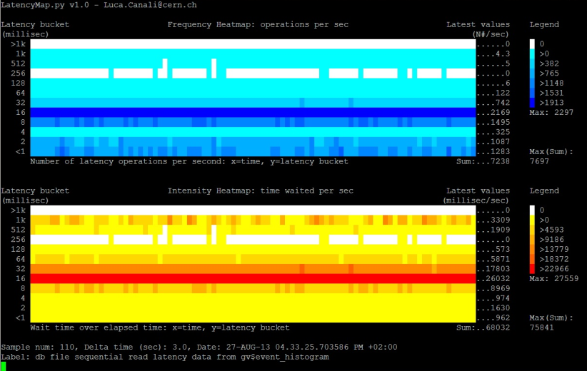
An Example of a Busy System

Slide 54
What Can We Learn?
Example of analysis
i.e. drill down ‘db file sequential read’
Are disks close to saturation?
NO, but latency high (SATA disks)
I/O outliers?
YES, Further investigation on controller needed
Do we have SSD/cache?
YES, ~30% reads with low latency
We could profit from a larger SSD cache maybe?

Slide 55
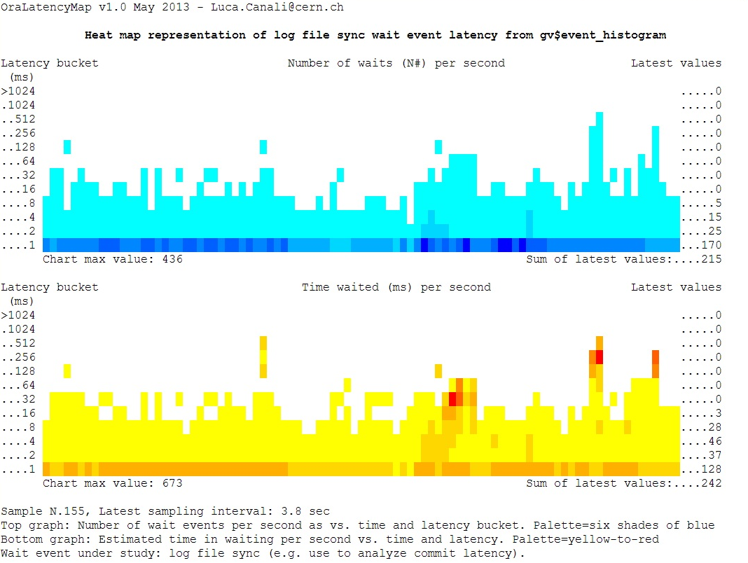
Log File Sync
Example from a production system
Low latency from
writes because of
storage cache

Slide 56
Log File Sync
Example from a production system
low latency from
writes because of
storage cache

Slide 57
Log File Sync
Example from a production system
Low latency from
writes because of
storage cache

Slide 58
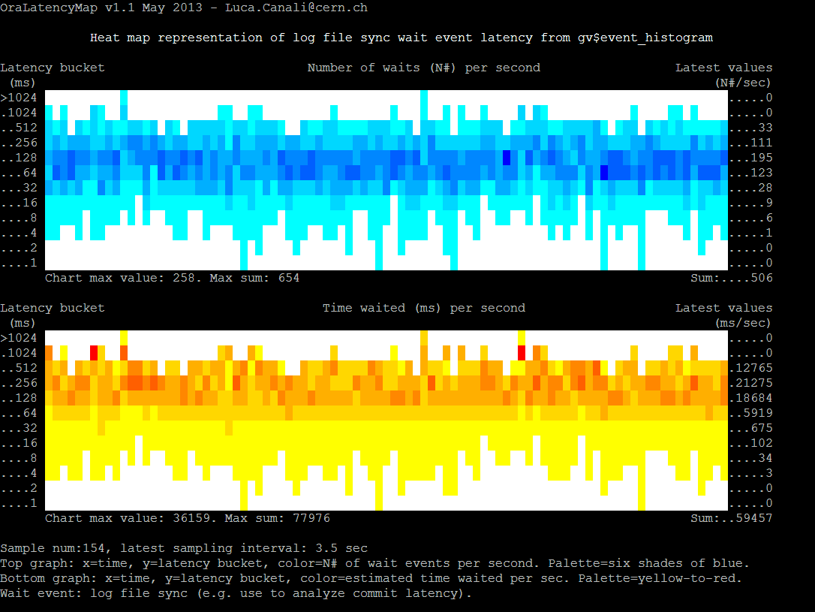
Log File Sync
Anomaly, on a test system
High latency
caused by HW
Issues and high
load from Oracle

Slide 59
Log File Sync
Anomaly, on a test system
High latency
caused by HW
Issues and high
load from Oracle

Slide 60
Log File Sync
Anomaly, on a test system
High latency
caused by HW
Issues and high
load from Oracle

Slide 61
Limitations
Wait event timing is done by Oracle code
May not reflect actual I/O service time
CPU time may also be accounted as I/O wait
Server high load can distort the timing values
V$event_histogram has only milli sec precision
Asynchronous I/O
Wait events of this family are very hard or impossible to utilize in the context of latency
Notes:
Asynch IO, for example in Linux for block devices: OS calls (ASM example): io_submit(), io_getevents
We can tap Oracle code with DTrace to see where the wait event timing is handled:
# this is for Oracle 11.2.0.3, Linux and Solaris: trace os process pid=1737 (edit os pid as relevant) dtrace -n ' pid1737:oracle:kews_update_wait_time:entry {
self->ela_time = arg1;
}
pid1737:oracle:kskthewt:entry {
printf("event#= %d, time(mu sec) = %d", arg1, self->ela_time);
}'

Slide 62
Blocking Calls
Db file sequential read
Is the easiest event to relate to I/O service time
Instruments single-block reads, blocking I/O
Note: in some cases Oracle can use async I/O for random reads, e.g. for prefetching and batching. Wait event used in that case is ‘db file parallel read’
Log file sync
Big part of the commit-time wait
Complex: it’s not a pure I/O event
The root causes of high latency here can also be CPU starvation and LGWR behaviour (e.g. bugs)
Notes:
Log file sync: From 11.2.0.3 adaptive mechanism
Automatic switching to a poll-based method instead of post-based
Disable this behaviour with: alter system set “_use_adaptive_log_file_sync”='FALSE‘;
Disable Oracle optimizations such as prefetching when testing random reads. See SLOB documentation and parameters:
_db_block_prefetch_limit=0
_db_block_prefetch_quota=0
_db_file_noncontig_mblock_read_count=0

Slide 63
Latency and Trace Files
Latency data is available in 10046 trace files
With micro second precision
Allows drill down to session level
As opposed to using global GV$ views
SQL> exec dbms_monitor.session_trace_enable(sid,serial#)
nam='db file sequential read' ela= 977 file#=7 block#=29618220 blocks=1 obj#=82015 tim=1377520823036634

Slide 64
More Latency Sources
DTrace
Great performance tool, coming to Linux too
Can be used to gather I/O latency histograms
Use of the quantize operator
dtrace -n '
syscall::pread64:entry { self->s = timestamp; }
syscall::pread64:return /self->s/ { @pread["ns"] = quantize(timestamp -self->s); self->s = 0; }
tick-10s {
printa(@pread);
trunc(@pread);
}'

Slide 65
Outline
CERN and Oracle
Latency: what is the problem we are trying to solve
Storage latency in Oracle
Examples
Tools
Conclusions

Slide 66
Tools
Automate tedious tasks
Data collection
Visualisation
Provide data and help answer questions
Drill down on I/O wait events
Find trends and evolution
How does performance change over time
Is it Oracle workload changing or is it the storage that has become slow?

Slide 67
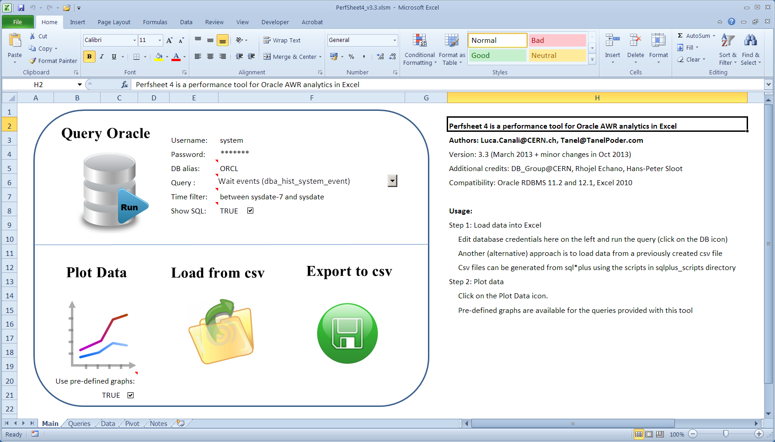
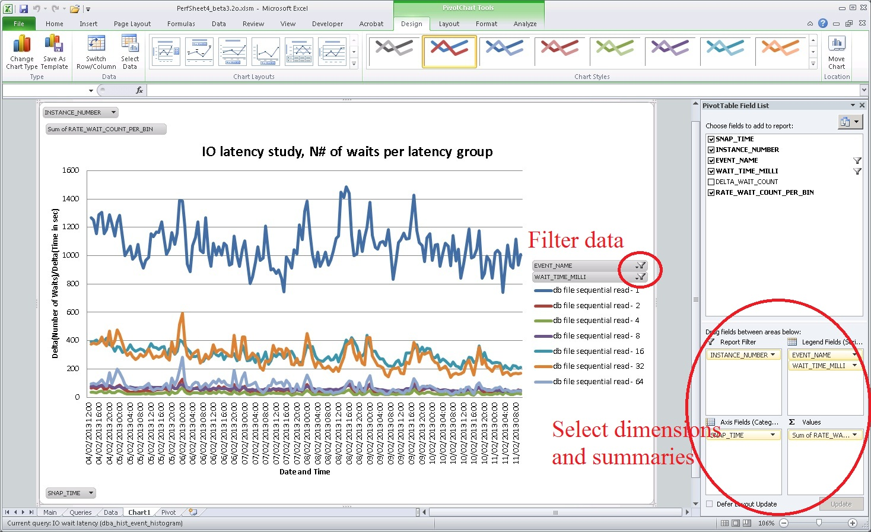
Tools: PerfSheet 4
Simple Analytic platform for AWR data
Predefined queries and graphs
Power of Pivot Charts

Slide 68
Tools: PerfSheet 4
Simple Analytic platform for AWR data
Predefined queries and graphs
Power of Pivot Charts

Slide 69
Tools: PerfSheet 4
Simple Analytic platform for AWR data
Predefined queries and graphs
Power of Pivot Charts

Slide 70
Tools: OraLatencyMap
It’s a SQL*Plus script based on PL/SQL
Lightweight, does not require any installation
Command line interface
Heat Maps generated using ANSI escape codes
Get started:
SQL> @OraLatencyMap

Slide 71
Tools: PyLatencyMap
It’s written in Python + SQL*Plus scripts
No installations required, CLI, lightweight
More advanced than OraLatencyMap
Can be used for generic latency sources
Oracle v$, trace files, AWR, DTrace data, etc
Pre-built examples available
Feature: record and replay

Slide 72
Getting Started with PyLatencyMap
Modular architecture
Source | <optional filter> | visualization engine
Get started
Video, getting started with PyLatencyMap
http://www.youtube.com/watch?v=-YuShn6ro1g
./Example1_oracle_random_read.sh

Slide 73
Outline
CERN and Oracle
Latency: what is the problem we are trying to solve
Storage latency in Oracle
Examples
Tools
Conclusions

Slide 74
Conclusions
Analysis of I/O latency
A powerful technique in performance tuning
Latency average is not enough, need histograms
Oracle wait interface has histogram details
PylatencyMap for data collection and visualisation
for Oracle and generic data sources
http://cern.ch/canali/resources.htm
Latency heat maps are great!

Slide 75
Acknowledgements
Our colleagues in the CERN Database Group
In particular: Ruben Gaspar
Many ideas borrowed from blogs and articles:
Brendan Gregg, Tanel Poder, Kevin Closson, Frits Hoogland, Marcin Przepiorowski, James Morles, Kyle Hailey, Cary Millsap

Slide 76
Thank you!
Luca.Canali@cern.ch
Marcin.Blaszczyk@cern.ch

